Slide 1
Machine Learning
Predict House Prices in Salt Lake City

Slide 2
What is Machine Learning
“[Machine Learning] is the field of study that gives computers the ability to learn without being explicitly programmed.”
- Arthur Samuel (1959)
Notes:
https://en.wikipedia.org/wiki/Arthur_Samuel American Computer Scientist who popularized the term “Machine Learning” in 1959

Slide 3


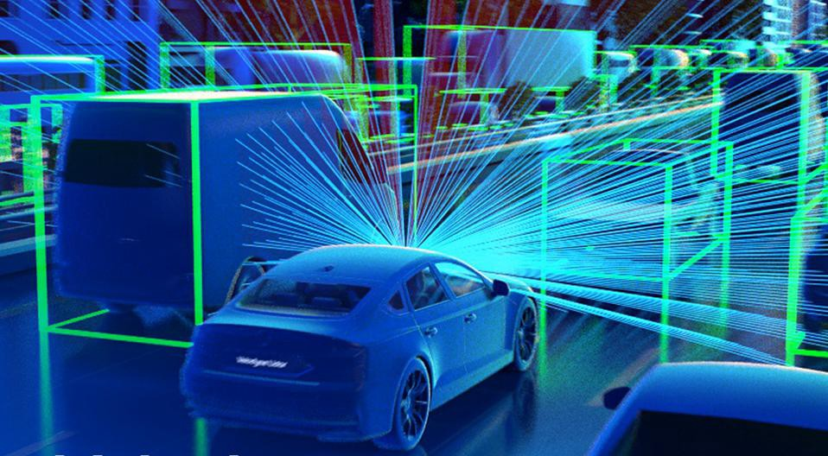
Machine Learning is All Around us!
Netflix
Financial Institutions
Automobile Industry
Recommending movies for you to watch
Identifying credit card fraud to protect you
Building self-driving cars
Notes:
Netflix: https://towardsdatascience.com/deep-dive-into-netflixs-recommender-system-341806ae3b48
Spotify:

Slide 4
Our first Machine Learning Algorithm: Linear Regression
Linear Regression is a machine learning model in which the model finds the best fit linear line between the predictors and outcome variable.

Slide 5
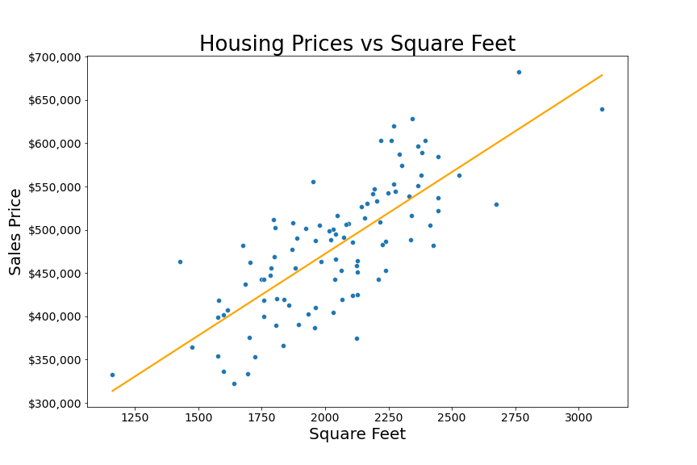
Linear Regression: Predicting Home Prices
Linear Regression Prediction Line
The machine learning model predicts “Sales Price” as a function of “Square Feet” using a “line of best fit” on the data.
Outcome Variable
Predictor

Slide 6
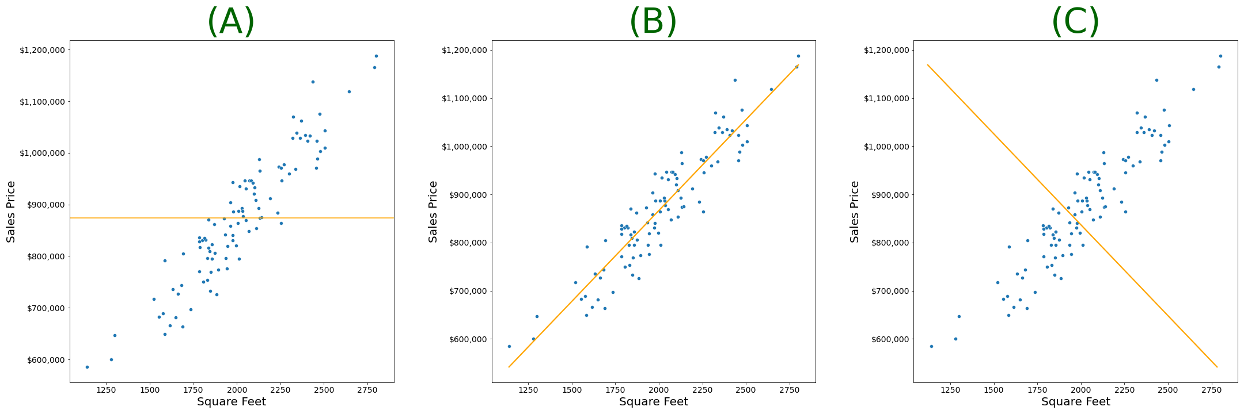
Group Exercise: Pick the Right model!
Notes:
Bonus Question
What does the model presented in (A) suggest about the relationship between square feet and sales price?
What does the model presented in © suggest about the relationship between square feet and sales price?

Slide 7
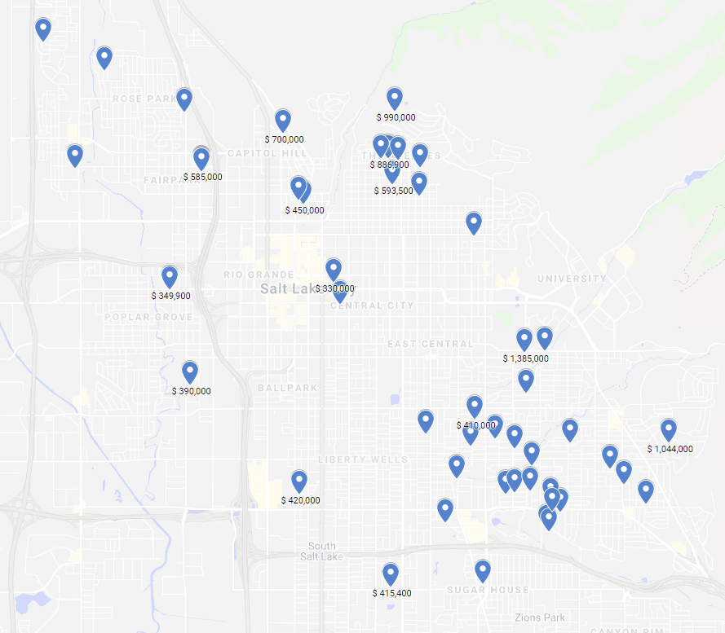
Another Group Exercise!
Residential Home Sales Prices in Salt Lake City
Google Maps Link

Slide 8
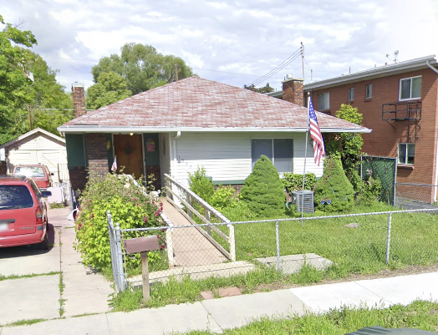
Predict the Price!
1832 S 1100 E, Salt Lake City, UT 84105
Square Ft: 1393
Bed Rooms: 2
Bathrooms: 1
Notes:
1832 S 1100 E, Salt Lake City, UT 84105
Add a view in Google My maps without the prices

Slide 9
Other Homes
Square Ft | Bed Rooms | Bathrooms | Price
1385 | 2 | 2 | $450,000
1634 | 4 | 2 | $620,000
1270 | 2 | 2.5 | $275,000
1475 | 2 | 1 | $420,000
1124 | 2 | 2 | $332,100
Square Ft: 1393
Bed Rooms: 2
Bathrooms: 1
Guesses
Participant | Guess Sales Price

